Slide 1
AIOB SMS V-HUB Signaling Topology
- Message Routing (Signaling) and Billing recommendations as per GSMA SMS HUB Guidelines
- Network Design Considerations

Slide 2
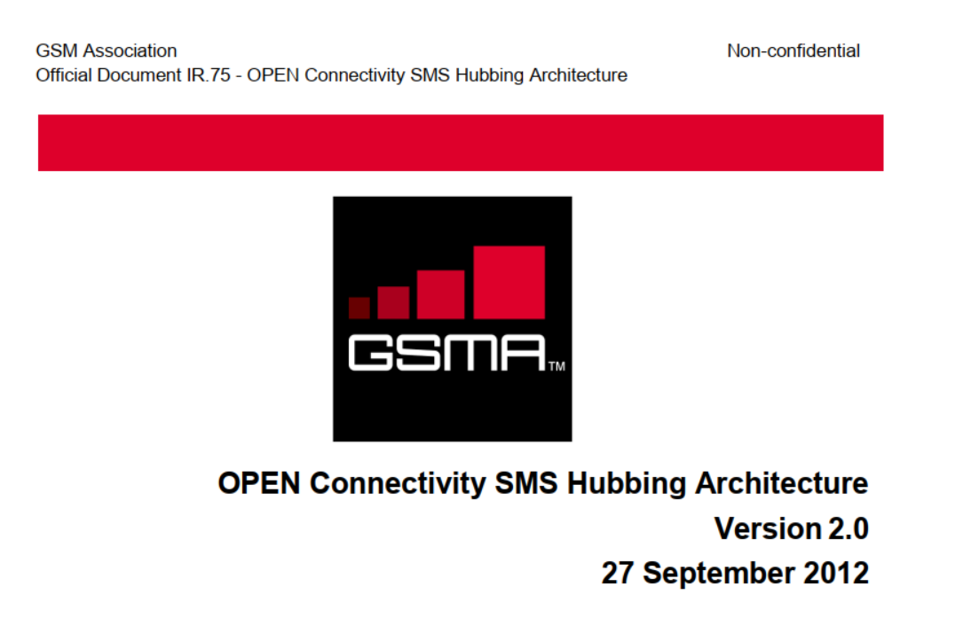
Important Recommendations from GSMA

Slide 3
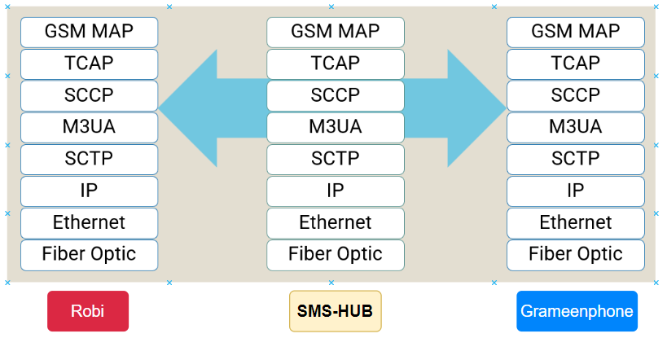
SIGTRAN Protocol Stack for SMS Transit through SMS HUB

Slide 4
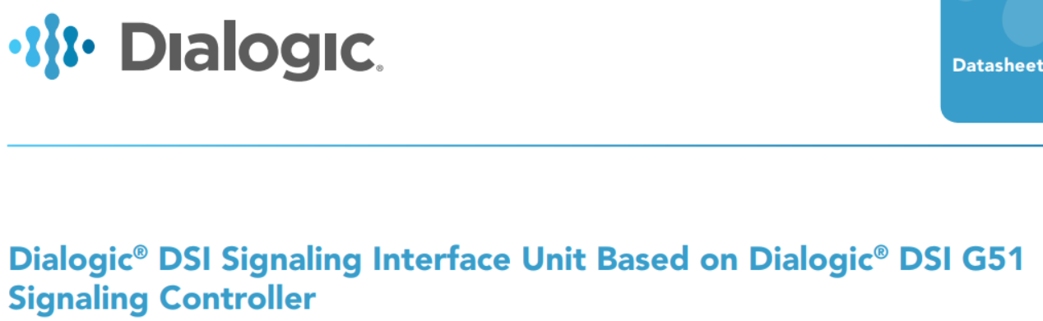
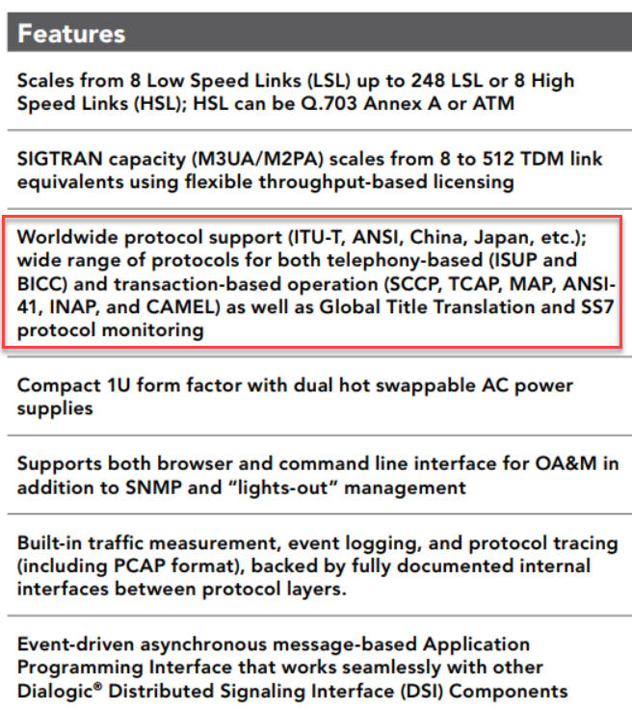
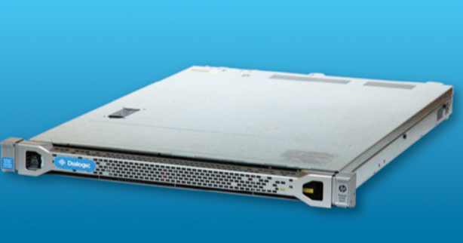
SMS HUB Equipment and Protocol Support

Slide 5
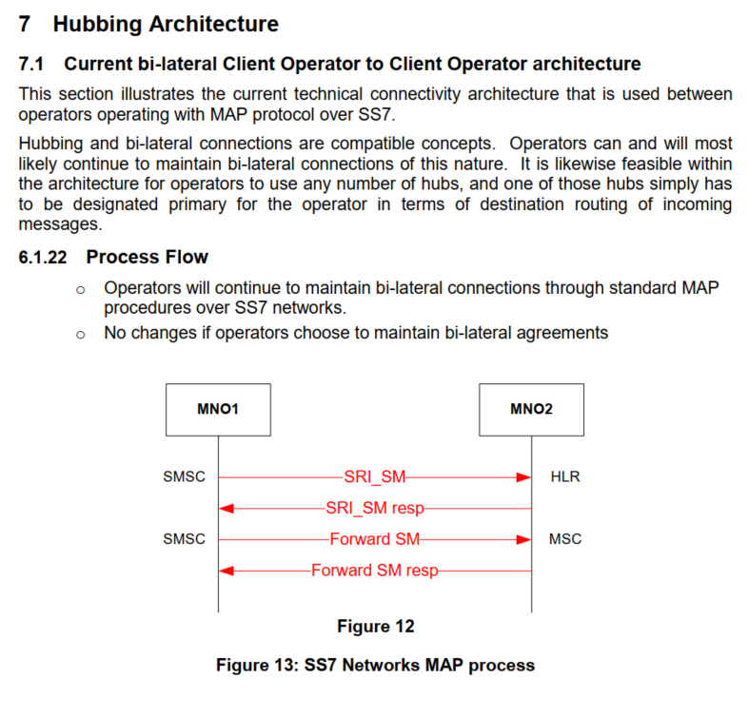
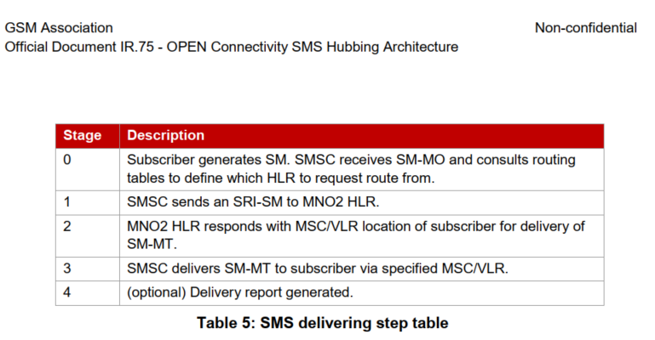
GSMA Process Flow for Signaling (Bilateral)

Slide 6
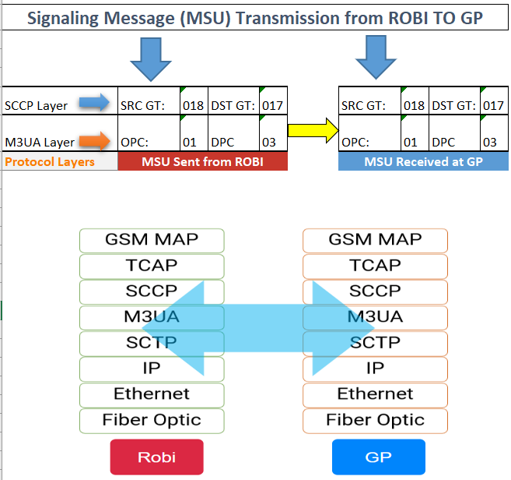
Example Message Routing (Bilateral)
Robi wants to send MSU to GP GT=017
Robi STP translates the GT to GP DPC=03
MSU or signaling messages are passed directly from Robi OPC to GP DPC

Slide 7
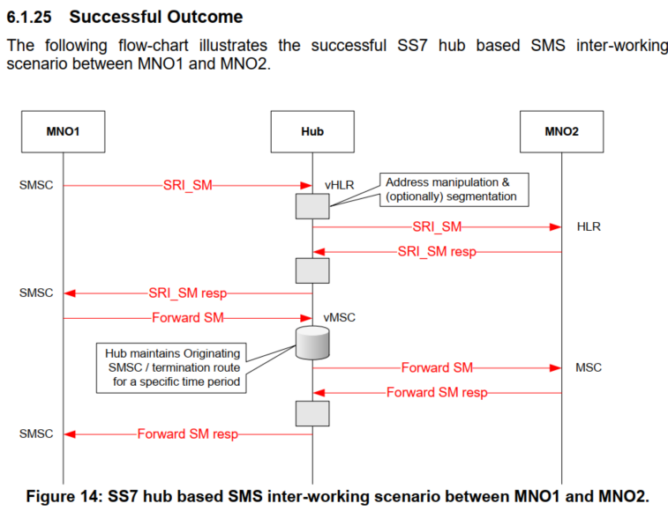
GSMA Process Flow for Signaling through HUB

Slide 8
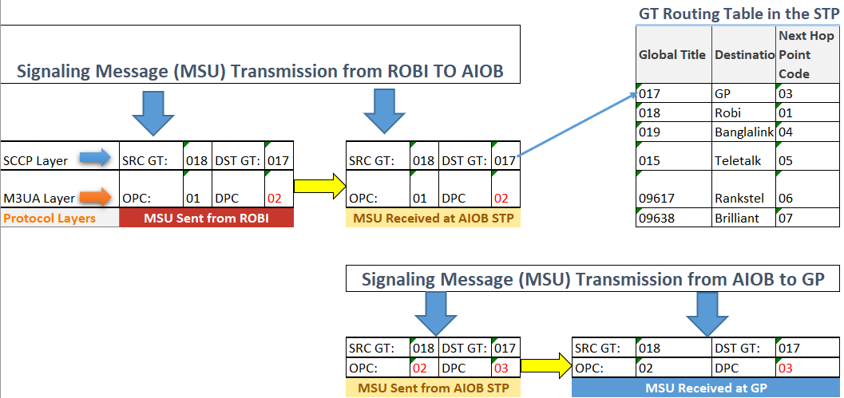
Example of Proposed Message Routing (Through SMS-HUB STP)
Robi wants to send MSU to GP GT=017
Robi STP translates the point code to AIOB STP DPC=02 and the packet reaches the STP
AIOB STP looks up GT translation table and translates the GT 017 to next hop point code GP DPC 03 and forwards the MSU

Slide 9
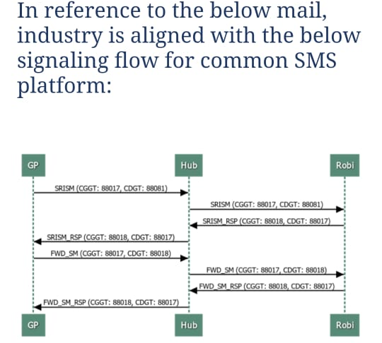
Acknowledgement from AMTOB on Signaling Process Flow

Slide 10
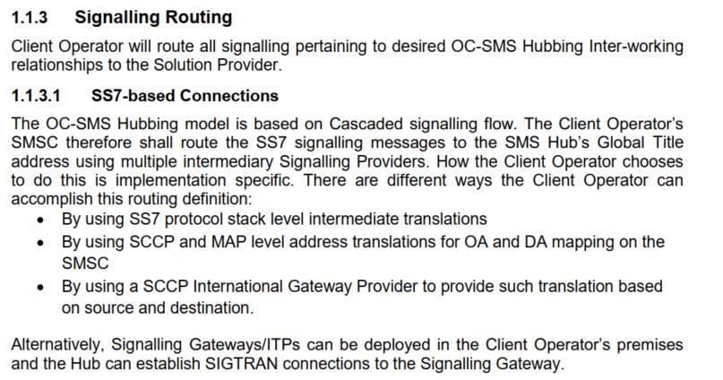
GSMA Recommendations for Realization of Signaling

Slide 11
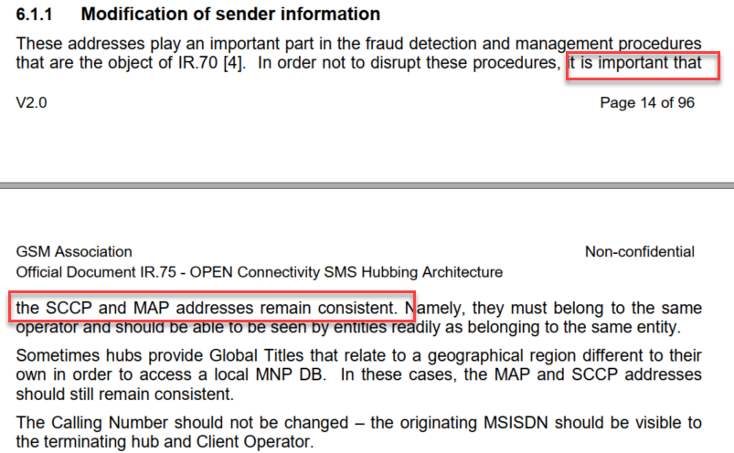
Recommendations on Preserving SCCP and MAP Addresses

Slide 12
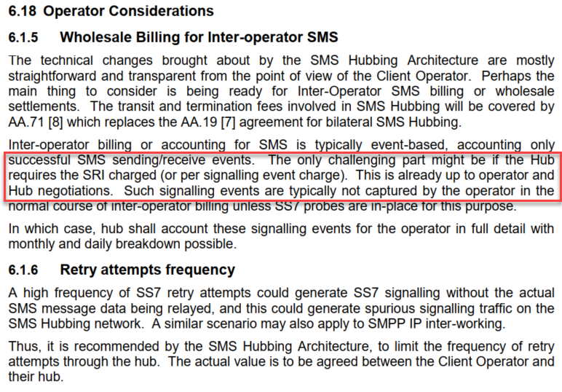
Recommendations on Billing
General recommendation is to bill on successful SMS sending/receiving
Optionally SRI can be charged, depends on HUB and operators negotiations

Slide 13
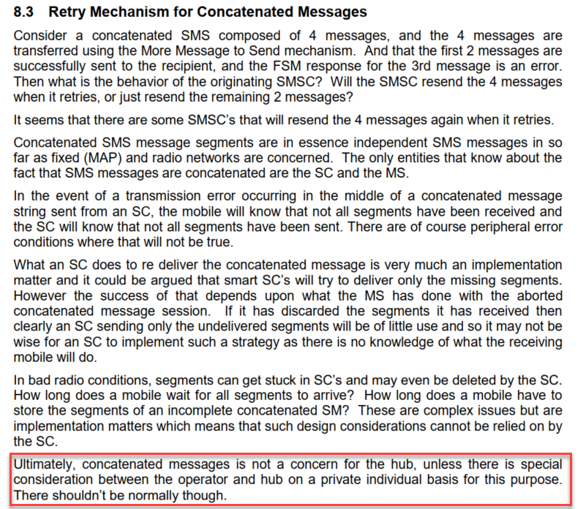
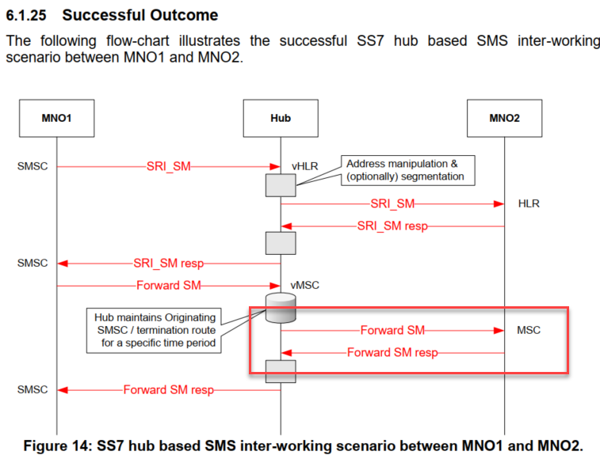
Recommendations on Concatenated Messages
MSG concatenation should not be a concern for Hub and hub will charge based on Forward SM Response for each Submission.

Slide 14
High Availability and Security at Various Protocol Layers
Site Level HA or Redundancy
Node Level HA
Card Level HA through SCTP Multi-Homing
IP backbone redundancy
  Multiple physical links
  BGP for dynamic and failover routing
Security using IPSEC and GRE Tunnel (SS7 attack+ source spoofing)
HA in IP Access Network
  VRRP
  Vlan Trunking
  OSPF over GRE tunnel

Slide 15
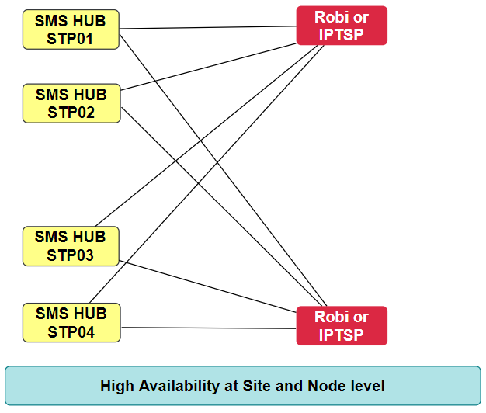
Site Level STP HA or Redundancy for SIGTRAN OR SCTP
Link-1

Slide 16
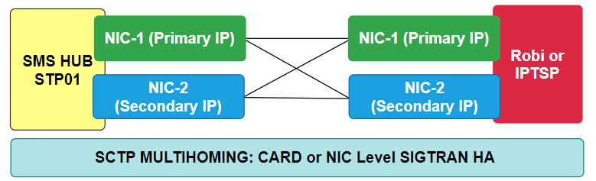
Card Level HA through SCTP Multihoming

Slide 17
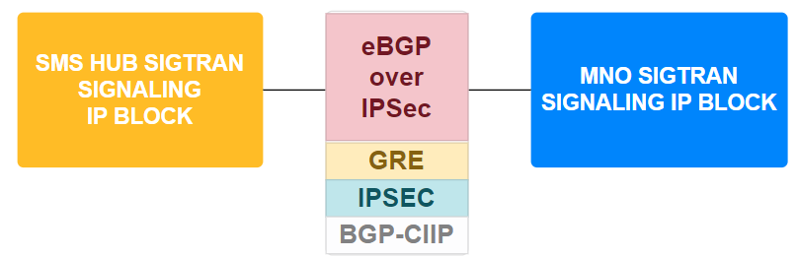
Use of BGP, IPSEC and OSPF
sigtran

Slide 18
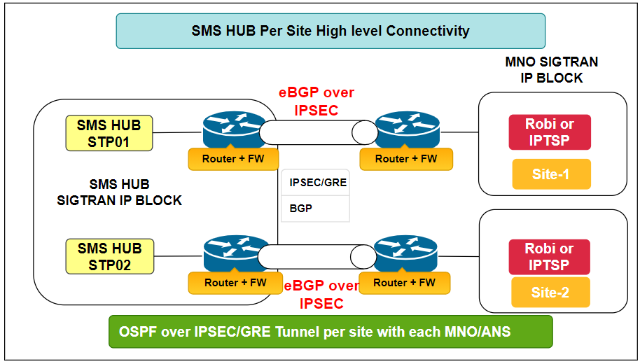
eBGP over IPSEC, One Session or Tunnel per Firewall Across Sites

Slide 19
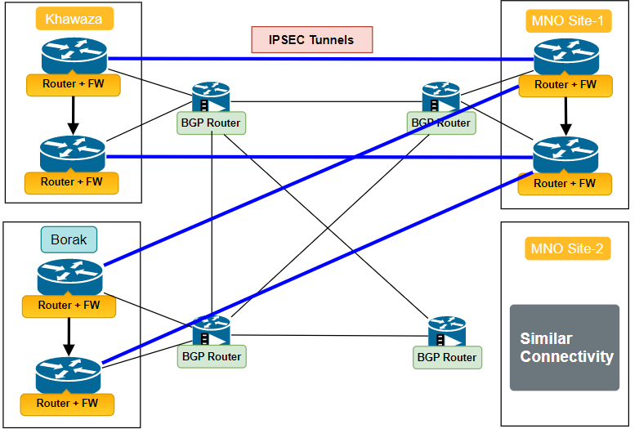
Redundancy in IPSEC Path through BGP Backbone

Slide 20
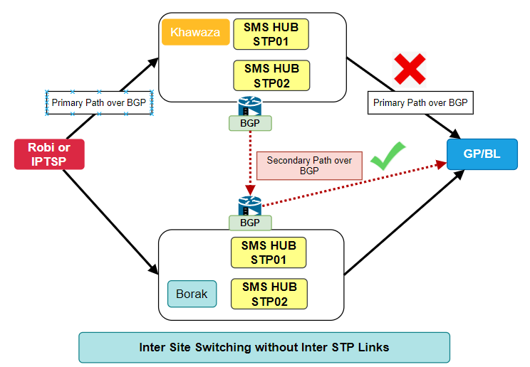
Inter Site SMS Switching without Inter STP Link

Slide 21
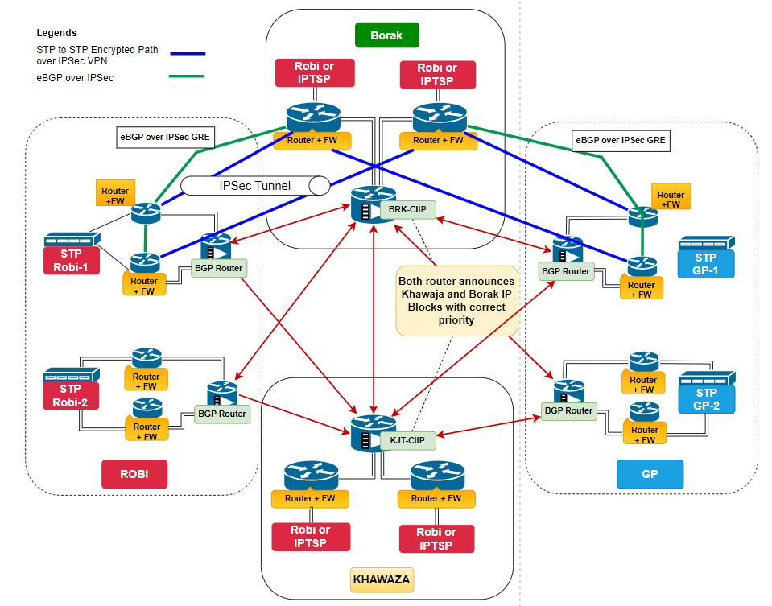
Overall Network Topology

